Slide 1
Abraham Trembley and the creature that defies classification
Filipe Faria Berçot
&
Maria Elice de Brzezinski Prestes

Slide 2
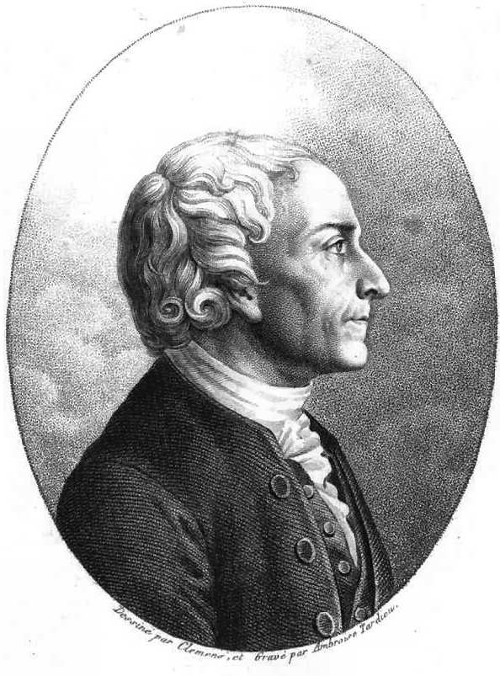
Abraham Trembley (1710-1784)
Abraham Trembley and the boys Anthony and Albert Bentick, collecting and observing organisms in the pond in front of the country house at Sorgvliet, illustrated in his book, Mémoires pour servir à l'histoire d'un genre de polypes d'eau douce (1744).

Slide 3
Publicity image of the 1996 Dutch film Charlotte Sophie Bentick, screenplay based on the book The Marriage Contract, by the Dutch novelist, essayist and poet Hella S. Haasse.
Portrait of Charlotte Sophie van Aldenburg (1715-1800)

Slide 4
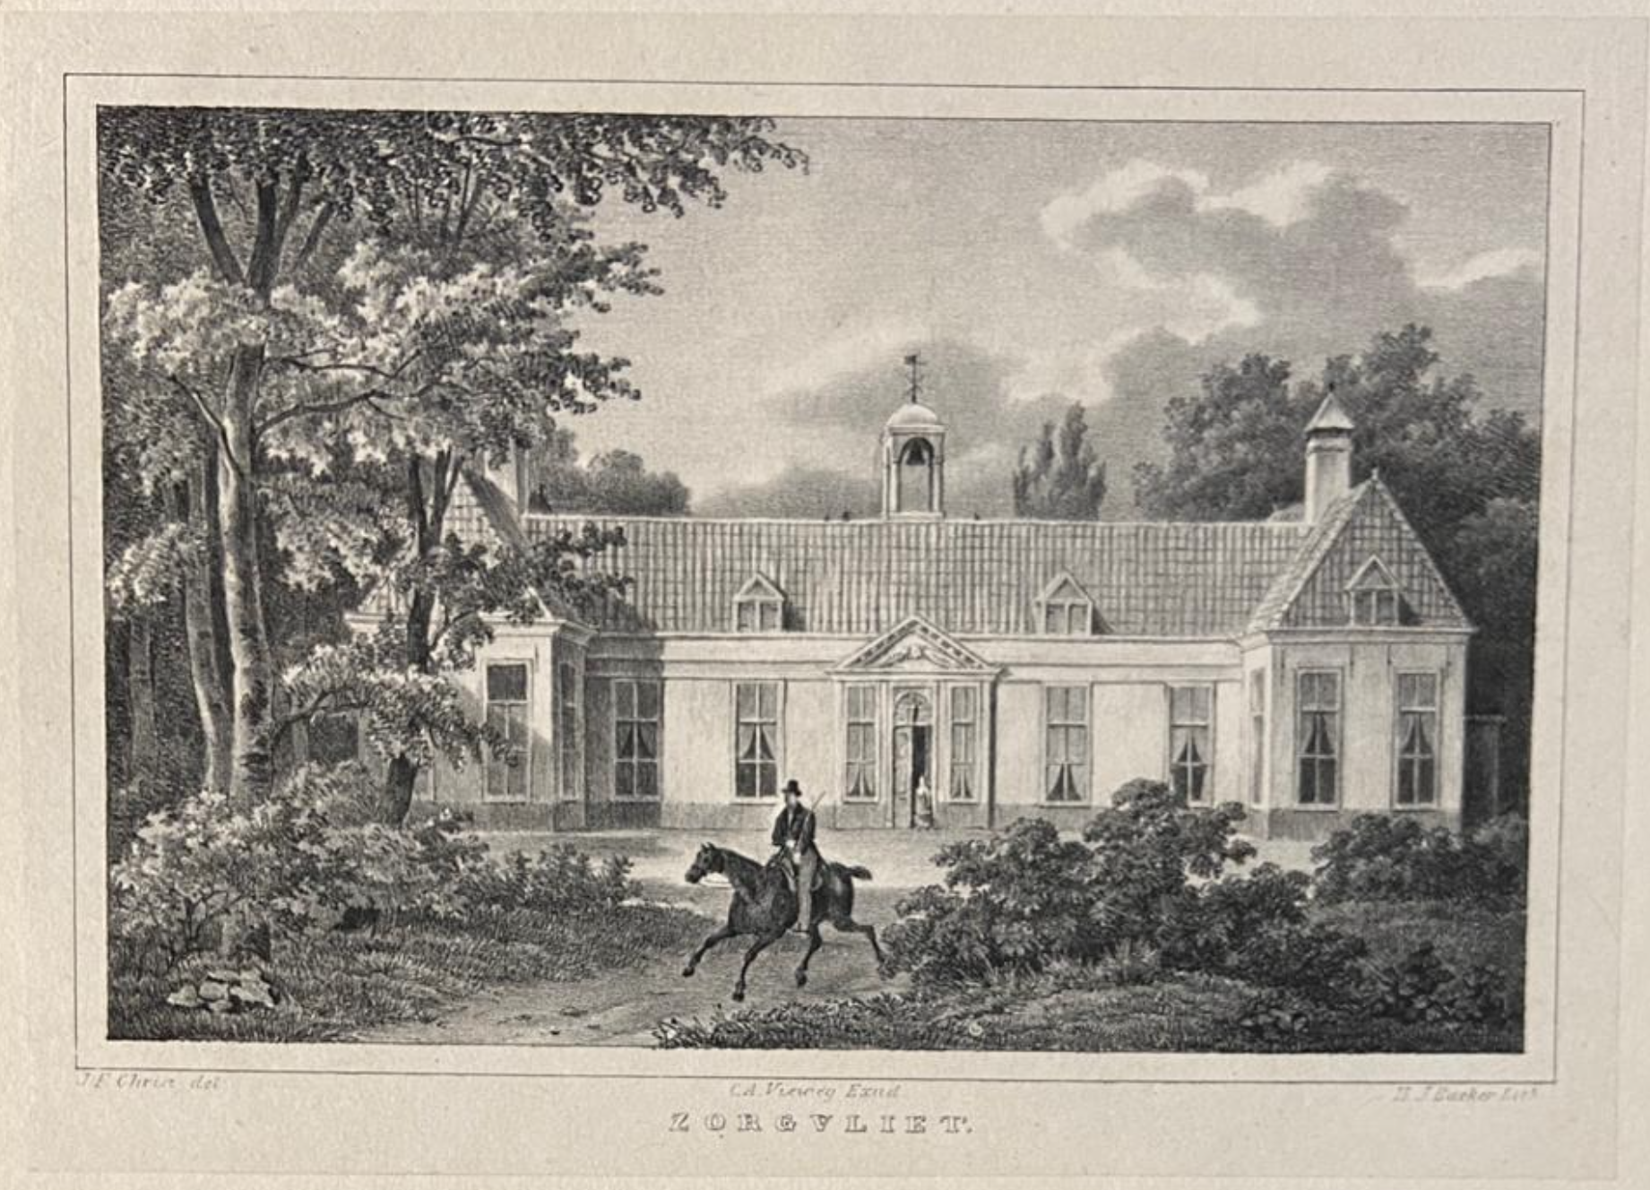
The house named Sorgvliet, literary “care flies”, by its owner, the statesman and poet Jacob Cats, was built in the late 1640s. All its ground-floor rooms overlook the garden, with native and exotic plants and herbs.
The state came into the possession of the Bentick Family in 1675.

Slide 5
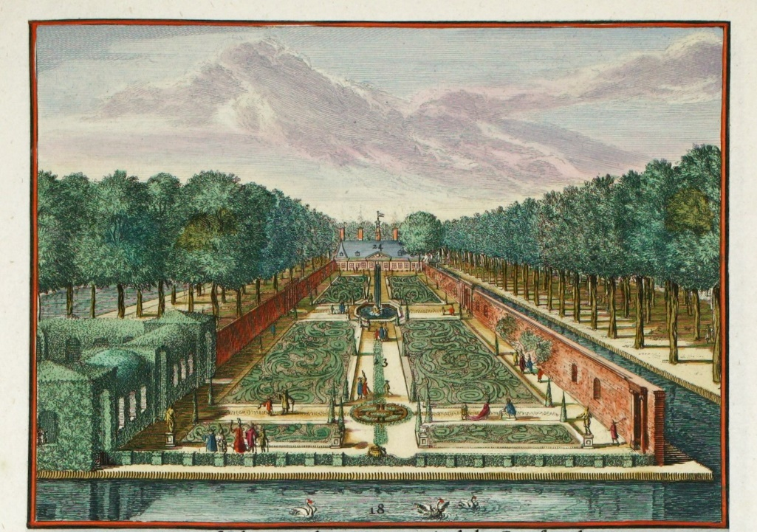
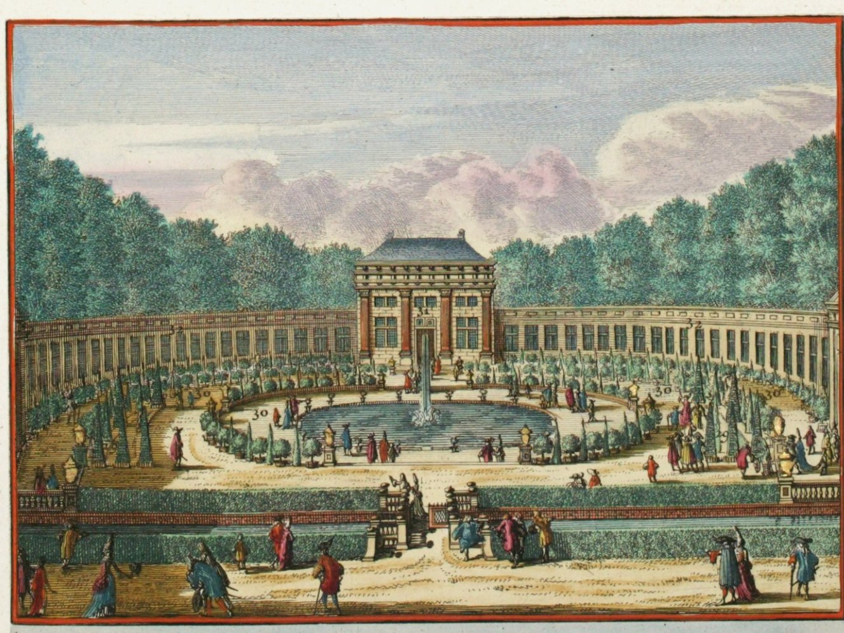
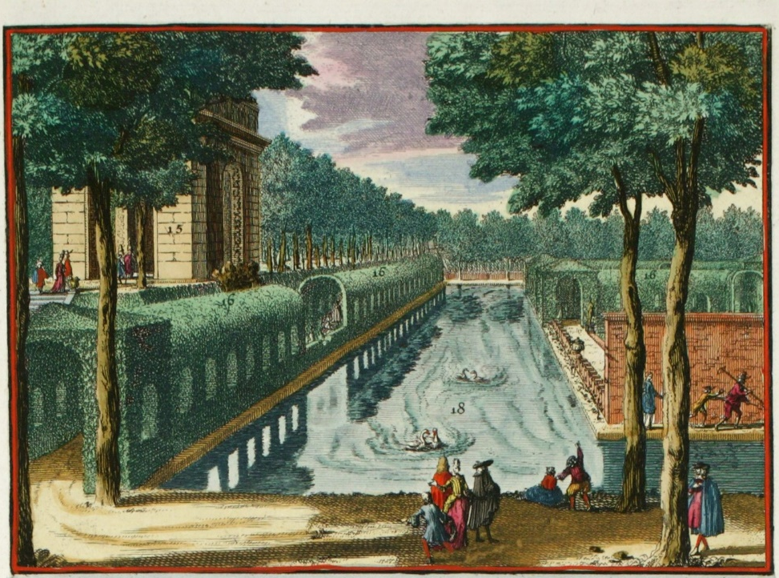
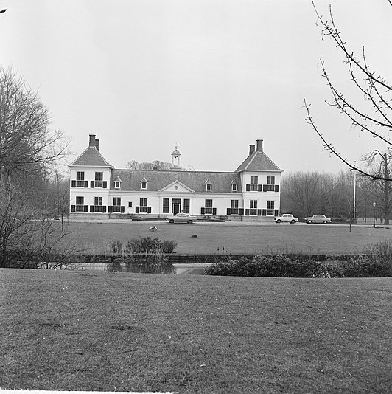
Preserved drawings show the land as a lush place, composed of a series of well-designed gardens, with many trees trimmed in conical shapes, hedge-covered tunnels, a symmetrical system of interconnected paths from one part of the gardens to another and an elegant ornamental system of ponds containing several species of exotic fish. Over the centuries, it has gone through several owners and renovations.
Today, the Catshuis, a National Monument inside the Sorgvliet Park, is a reception centre for the Netherlands government.

Slide 6
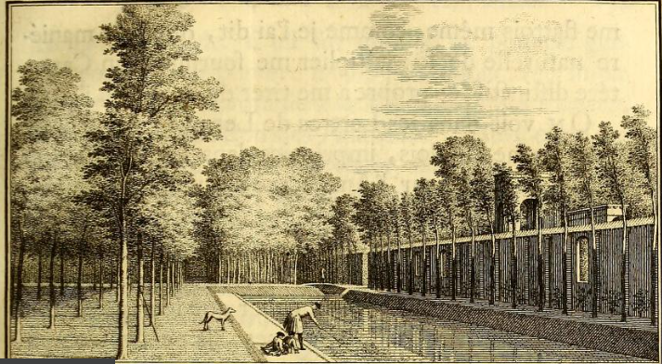

Slide 8
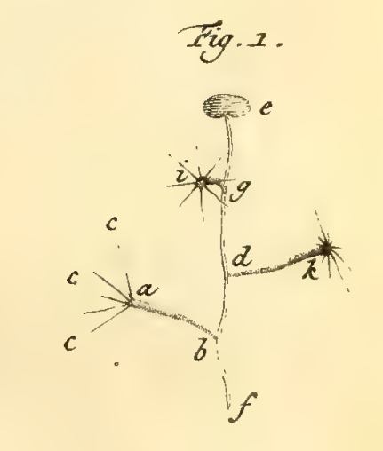
Fig. 1.
Three green polyps (ab; dk; ig) attached in a leaf of water lentil (ef).
In “c”, the “arms” of a polyp (ab).
THE CREATURE

Slide 9
M O V E M E N T
Fig. 2.
A polyp performing “body” contortion movement (ab).
Fig. 1.
A polyp apparently moving its “arms” voluntarily.

Slide 10
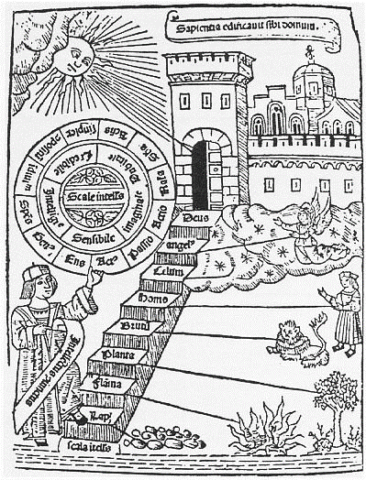
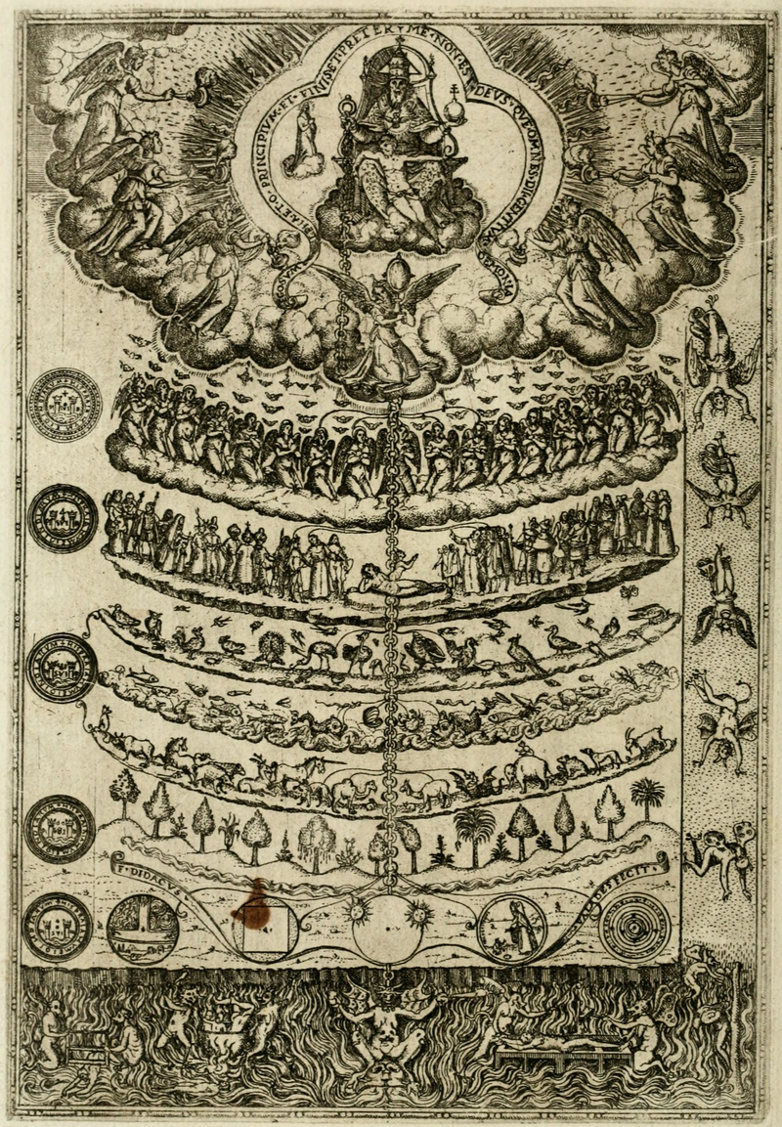
Great Chain of beings (1579).
Scala naturae (1305).
A medieval scale of “beings” showing levels of progress .
Notes:
Inserir crédito imagens em slide final: 1. Drawing from Ramon Llull's Ladder of Ascent and Descent of the Mind, 1305 [inserir numeração na narrativa]
2. Drawing from Didacus Valades, Rhetorica Christiana [inserir numeração na narrativa]
2.

Slide 11
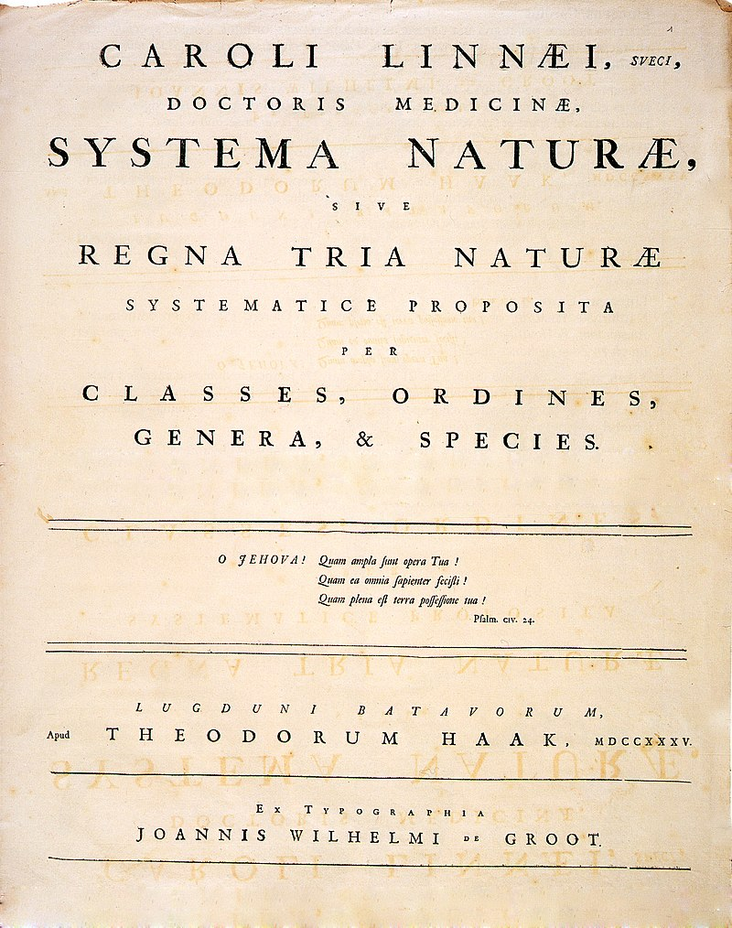
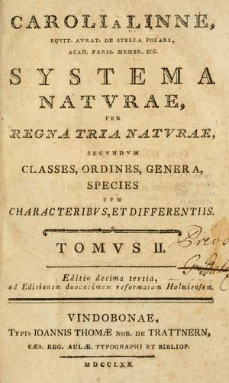
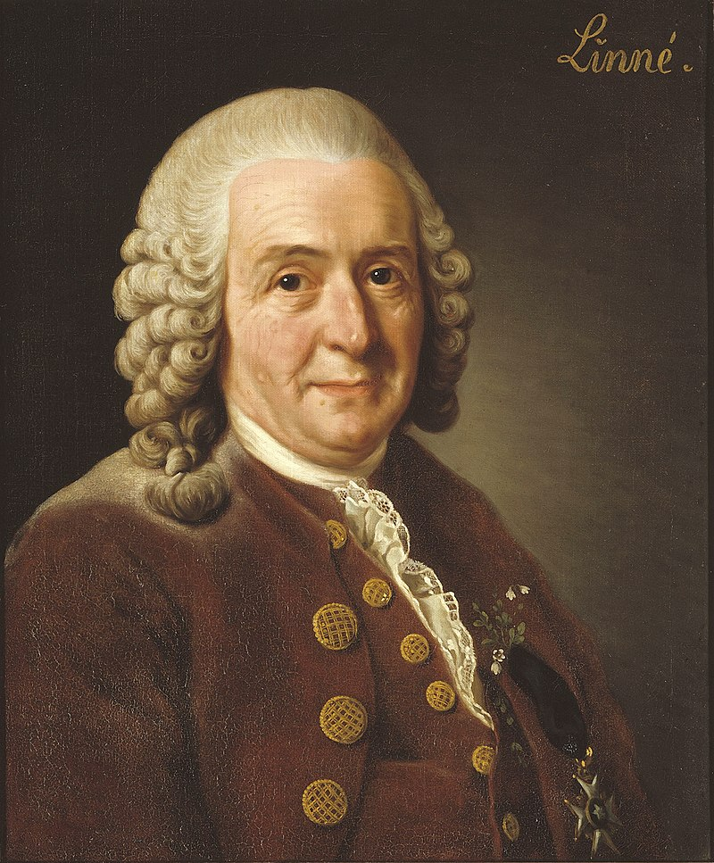
Carl von Linné
Systema Naturae.
The first edition published in 1735 and the 13th edition, in 1770..

Slide 12
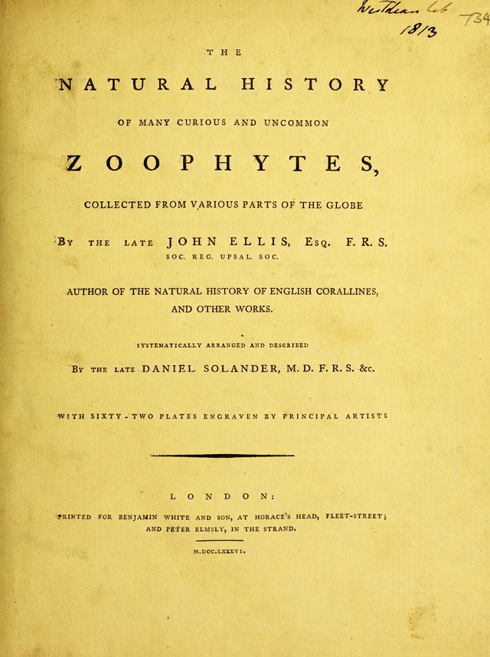
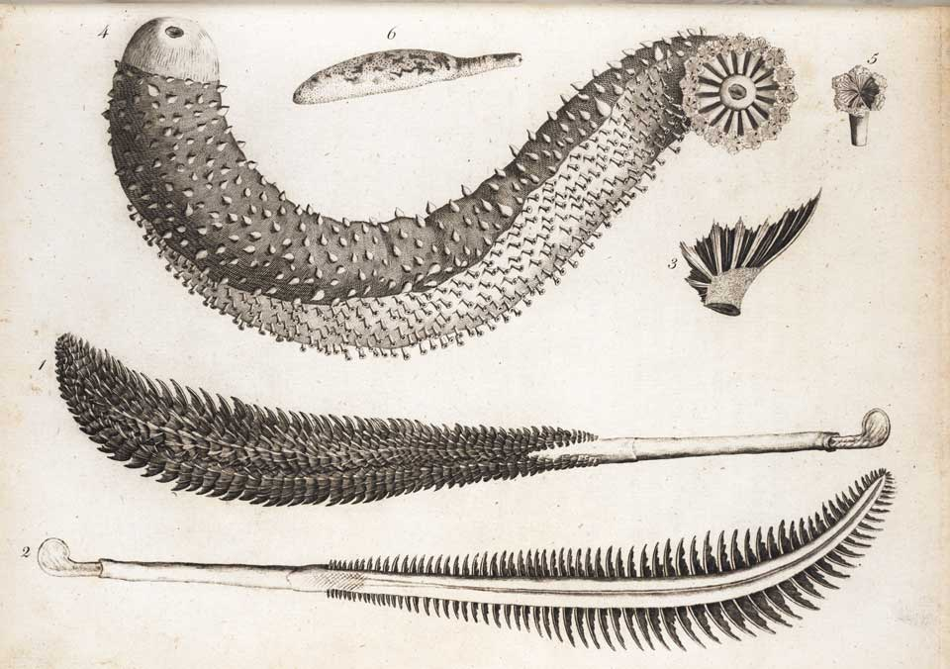
Sea cucumber (top). Sea pens (bottom).
Natural History of Many Curious and Uncommon Zoophytes. John Ellis, 1786.

Slide 13
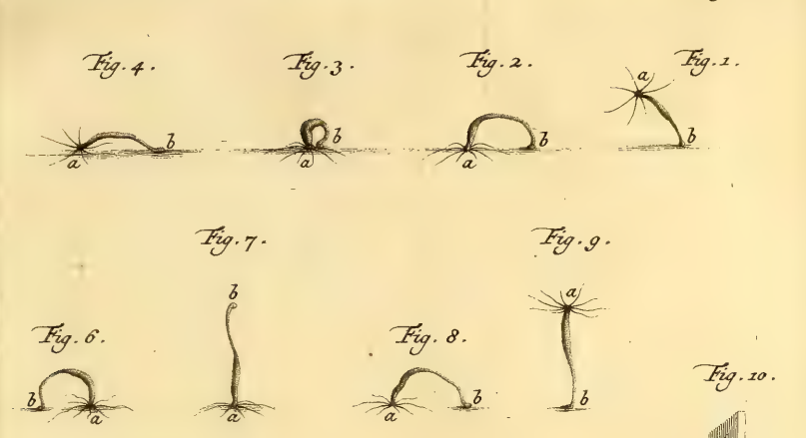
Fig. 1-9. Modes of locomotion of the polyps: worm-like movement represented in the top line, from the right to the left (Fig..1–4), and by somersaults, in the bottom line, from the left to the right (Fig. 5–9).
LOCOMOTION

Slide 14
[Think 1] Facing this deadlock, plant or animal, Trembley must take a stand. At this point and based on these data, what could you say about the nature of these organized bodies? What would justify the choice in favor of one trait or another? What might “carry more weight” or motivate such an option?
[THINK 1]

Slide 15
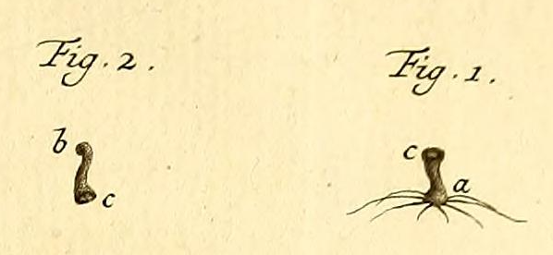
CUT OFF
Fig. 1-2.
A polyp cut into two parts. Fig 1. represents the upper part with the “horns” (a).Fig 2.the lower part (bc) or the "body" of the organism.

Slide 16
[Think 2] Through his previous observations, Trembley believes that the creatures are animals. Yet he performed the experiment of cutting the specimen. How could the results obtained throughout the experiment help to guide him to take a decision?
[THINK 2]

Slide 17
[Think 3] Previously, voluntary movement and locomotion seemed to be the most essential criteria in considering the organism as an animal. What is to be done in the face of this new result? How should this new evidence be interpreted in terms of the modes of reproduction?
[THINK 3]

Slide 18
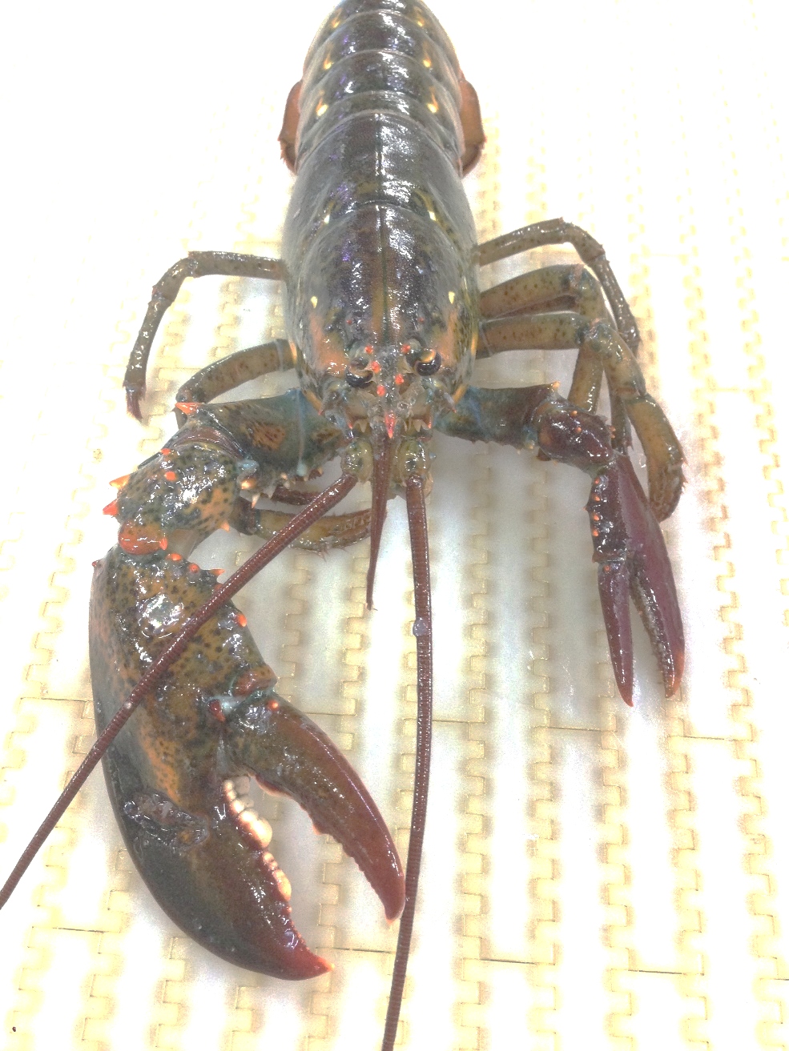

Slide 19
[Think 4] We are facing a dilemma similar to the initial (Think 1), but now it seems worse! Would it be a dead end? Is it necessary to adjust observations (more experiments or more information)? Or should you review your classification criteria of organisms inside the groups of animals and plants? Feel free to put down your thoughts about it!
[THINK 4]

Slide 20
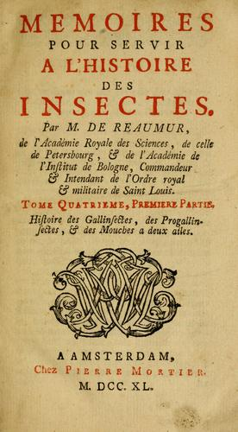
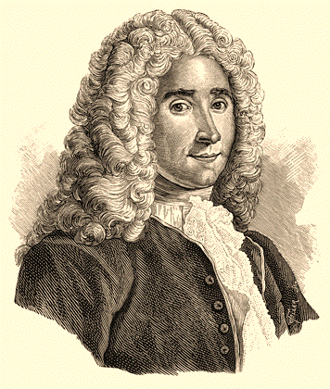
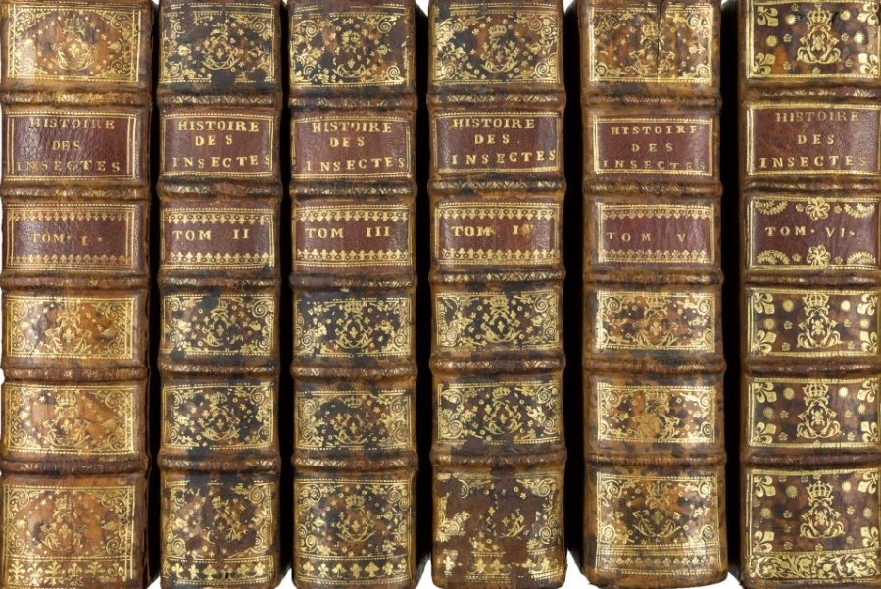
Memoires...
Memory to serve the history of insects.
Six volumes published between 1737 and 1742.
René Antoine Ferchault de Réaumur

Slide 21
[Think 5] Remembering you are handling small aquatic creatures. Why do you think they did not survive the trip? What procedures and care do you think are necessary to avoid the death of these organisms during a trip, by horse or carriage, from The Hague to Paris?
[THINK 5]

Slide 22
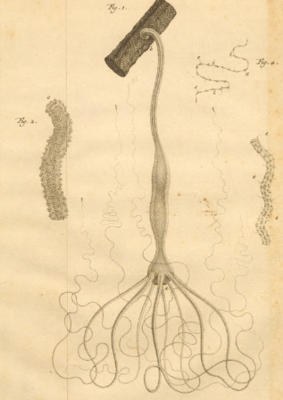
Polyps, named by Réaumur.
Octopus anatomy..
POLYPS
Notes:
Baker (1757). https://www.sciencephoto.com/media/433578/view/octopus-anatomy-18th-century

Slide 23
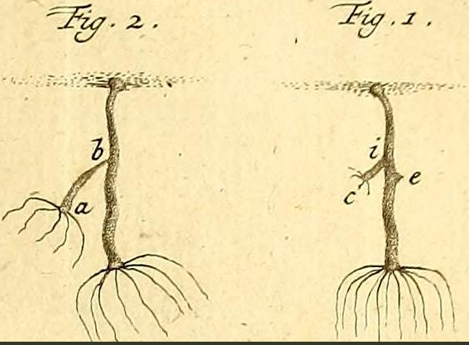
Fig. 1-2.
Fig. 1. A polyp with a bud (e) and a and a young growing polyp (ic).
Fig. 2. A polyp (ab) about to break free from the mother's body.
REPRODUCTION…?

Slide 24
[Think 6] One more time, it seems that we have reached a “non-expected” outcome. How should it be interpreted? How could this observation help you to classify the creature? Would it be time to change your position (developing, for instance, an animal–plant concept)? Explain it.
[THINK 6]

Slide 25
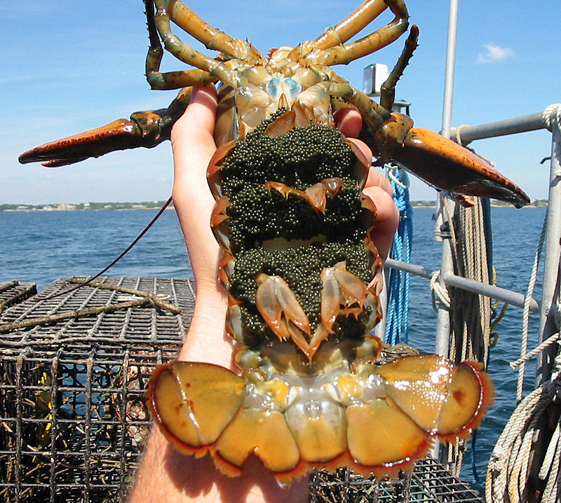
Female lobster
The eggs “hidden” at the bottom of the abdomen.

Slide 26
[Think 7] What would be the reasons “behind” Reaumur’s skepticism about generation by budding on polyps? What would have motivated him not to accept that an animal can be generated by budding? What would you do to convince him about Trembley’s new observations and the reliability of the data?
[THINK 7]

Slide 27
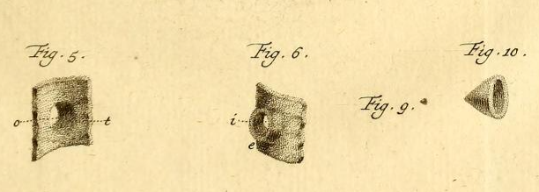
Fig. 5-6. Fig. 9-10.
Fig. 5-6. represents the inner side of part of the wall of a polyp and a communication (t) between the skin of the mother polyp and the bud and the letter "o" represents part of the skin of the removed bud that remained on the body of the mother polyp. Fig. 10. Indicates the bud (fig. 9.) extracted and seen under the microscope.
EGGS…?

Slide 28
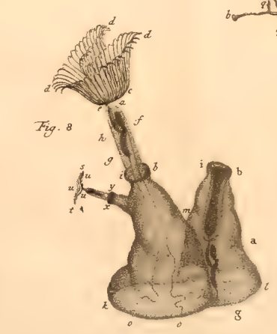
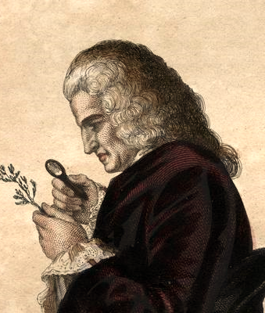
A specimen of a “feather polyp” that Réaumur and Jussieu believe to have found eggs.
A glass jar containing a ‘feather polyp’
Bernard de Jussieu
Notes:
(Plumatella genus). Pierre-Simon Pallas (1778).

Slide 29
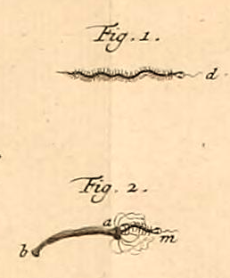
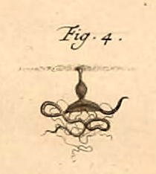
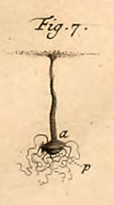
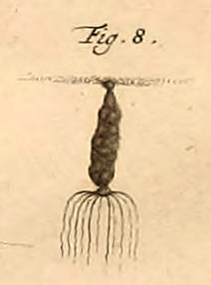
Fig. 1. A millipede worm less than 2mm long. Fig. 2. The arms of a polyp (ab) grasp a millipede worm (m) and direct it towards its "mouth". Fig. 4. A polyp grabbing a worm and preparing to swallow it. The polyp's "mouth" is extended and the worm is entwined in the polyp's arms. Fig. 7. A polyp with its "mouth" extended and apparently "ingesting" an aphid (p). Fig. 8. A polyp with its "stomach" full of aphids.
CAPTURING PREY…?

Slide 30
[Think 8] Do you think that just the action of “trapping a supposed prey” can be sufficient to make someone consider an organism as an animal? If so, in such cases we can surely say that a carnivorous plant (such as Dionaea muscipula) is an animal. Right? No? Maybe? Why? Is this situation another dead end or do you need to obtain more knowledge? What else could you require to take a decision?
[THINK 8]

Slide 31
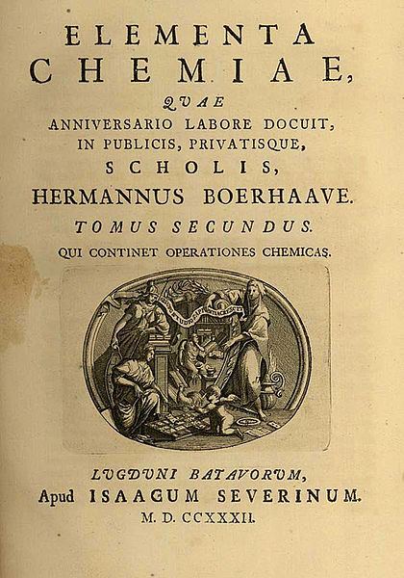
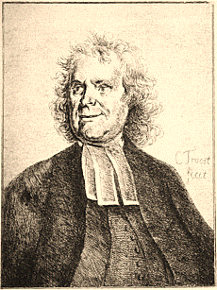
Elementa Chemiae (1732)
Elements of chemistry
Herman Boerhaave

Slide 32
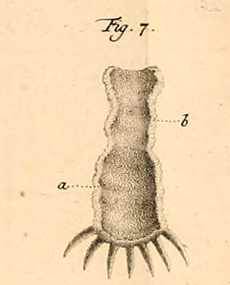
Fig. 7.
A polyp under microscope with cross-section: opened along its length from one end to the other. In (a) the inner part or walls of the "stomach". In (b), the skin slice.
NOURISHMENT…?

Slide 33
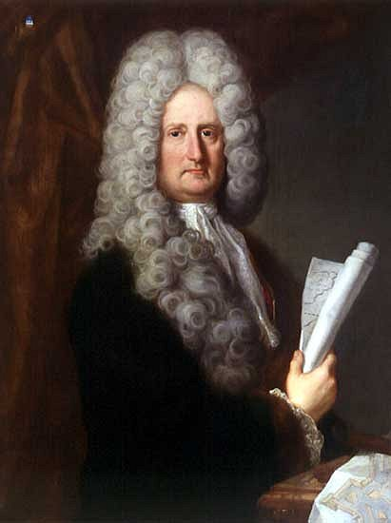
Histoire physique
de la mer (1725)
(Physical history of the sea)
Luigi Ferdinando Marsigli

Slide 34
[Think 9] As seen, Trembley found support in the different knowledge available at the time about the nourishment of animals and plants. Yet, apparently, none of these contributions seem to shed light on the polyp nutrition system. What would have been, then, the role of this knowledge in his research?
[THINK 9]

Slide 35
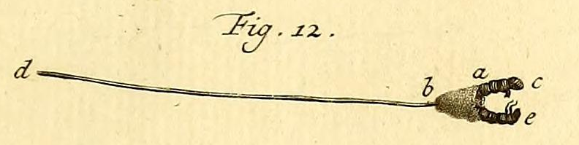
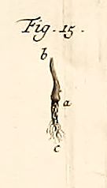
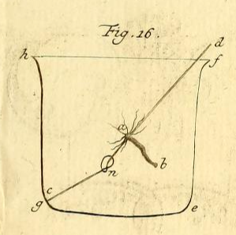
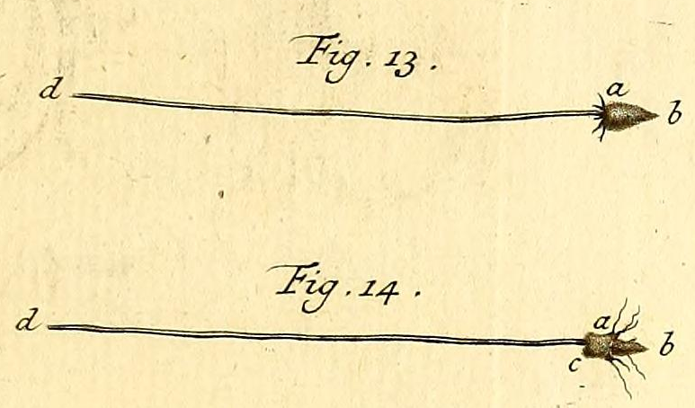
Fig. 12-16.
Using only a boar bristle (d), the palm of his hand (several attempts and a lot of patience, of course) Trembley managed to turn a polyp inside out (fig. 15), loop it around and trap it in a glass container (fig.16)!
THE INVERTED POLYP!

Slide 36
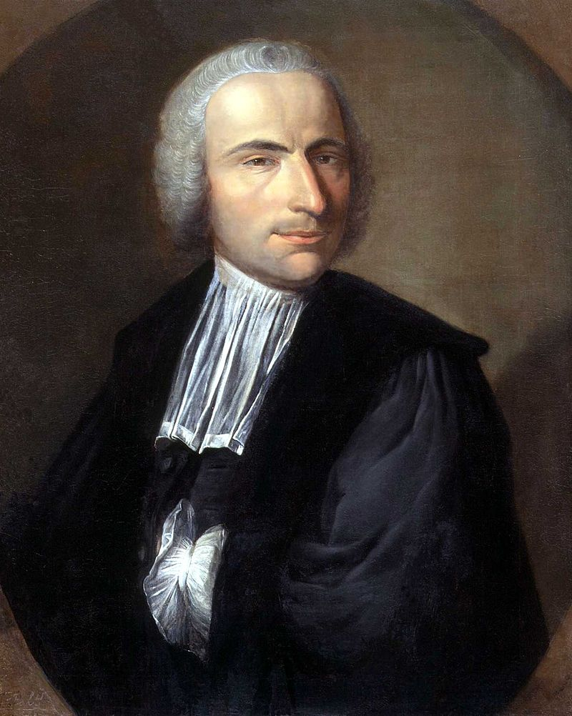
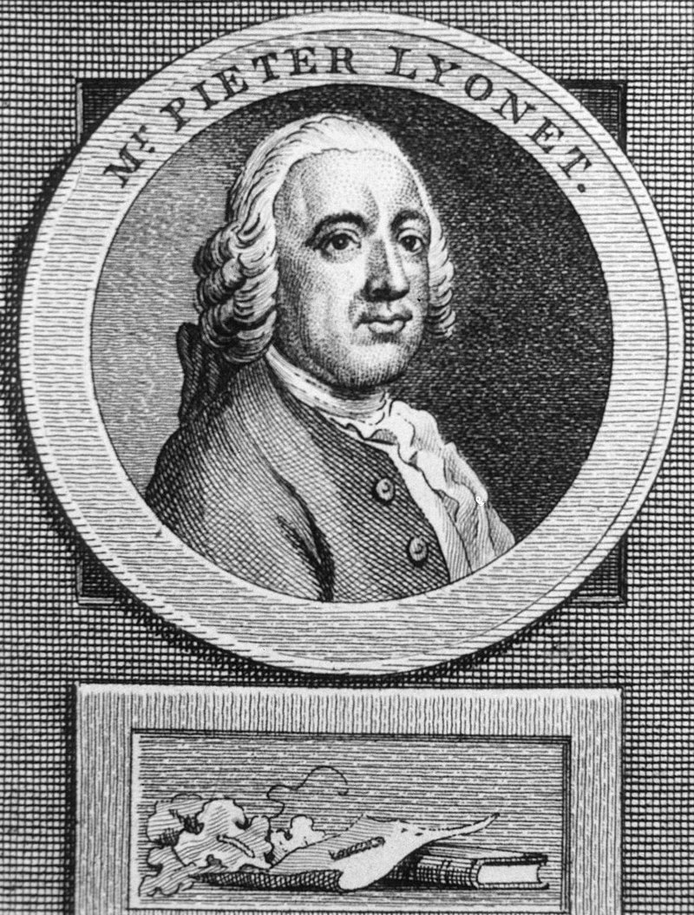
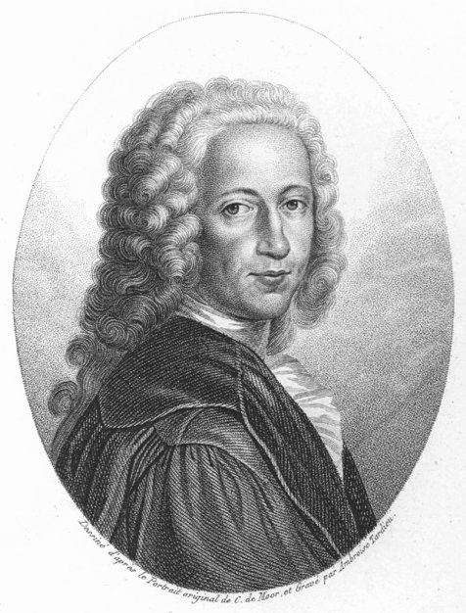
Pierre Lyonnet
Jean-Nicolas
Sébastien Allamand
Bernhard Siegfried Albinus

Slide 37
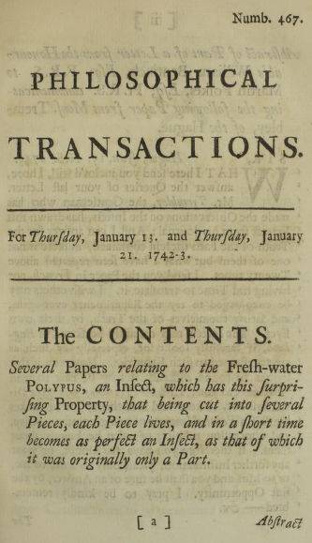
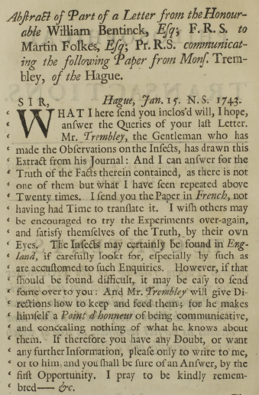
Philosophical Transactions
Trembley's work is published in the prestigious British journal in 1743.
THE FAMOUS POLYP!

Slide 38
[Think 10] Why, even after several public presentations witnessed by many people, was there still resistance to accepting the complete regenerative ability of polyps? What might be the reasons for such skepticism? What could be done to respond to unbelievers?
[THINK 10]

Slide 39
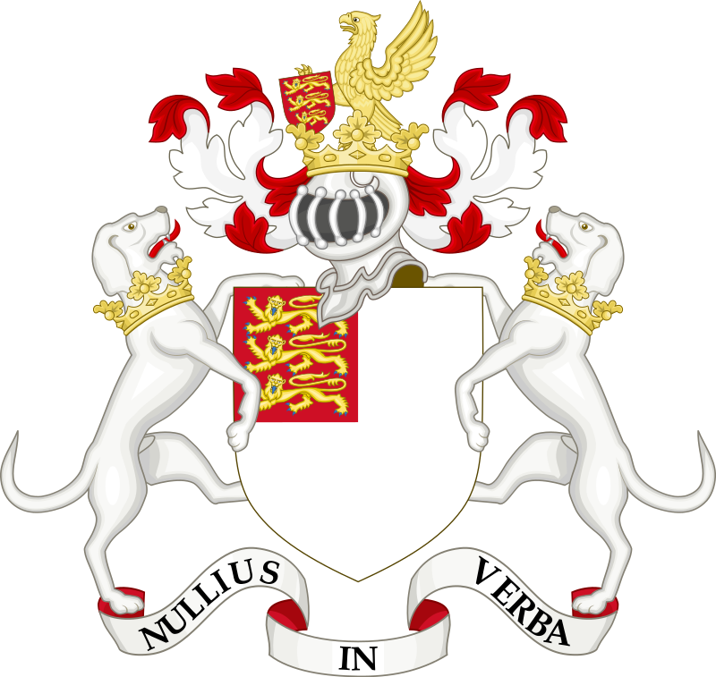
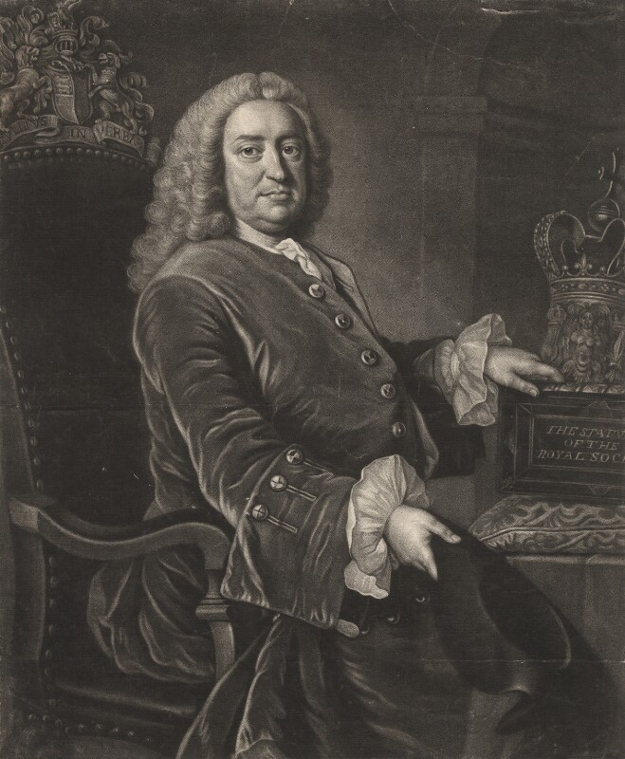
Royal
Society
Sir Martin Folkes, the President of the Royal Society n 1743.
Sir Martin Folkes

Slide 40
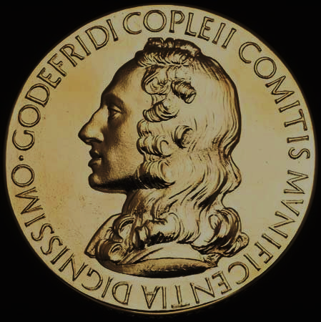
“
The Copley Medal is the Society’s oldest and most prestigious award. The medal is awarded for sustained, outstanding achievements in any field of science.
“
(Royal Society)

Slide 41
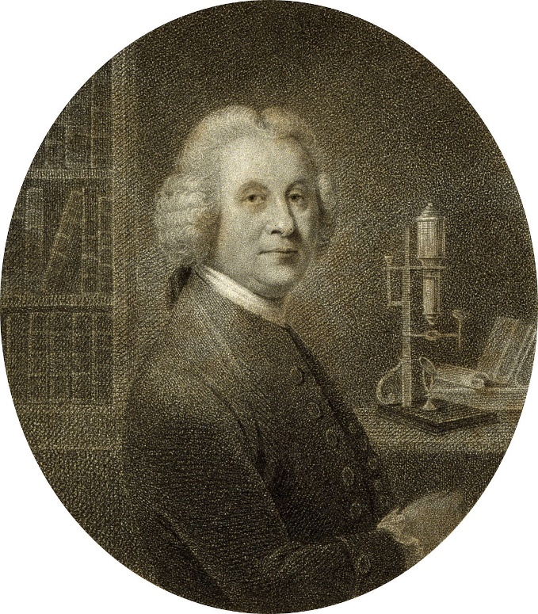
Natural history of the polype (1743)
Henri Baker

Slide 42
[Think 11] What is to be done regarding this real situation of anticipating results obtained by others? Is it plagiarism? Do you think the situation could influence Trembley’s “strategy of generosity”? How? What could have been the consequences for Baker?
[THINK 11]
[THINK 11]

Slide 43
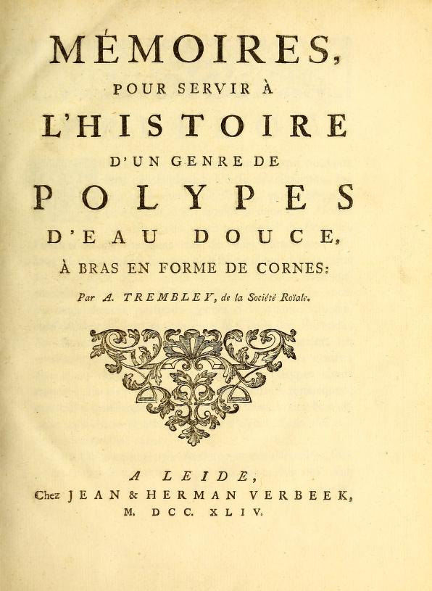
(Memoirs concerning the natural history of a species of freshwater polyp with arms in the shape of horns)
Mémoires pour servir à l’histoire d’un genre de polypes d’eau douce, à bras en forme de cornes (1744)

Slide 44
NOS features included:
A. The role of observation and interpretation of evidence [think 1]; [think 9]
B. The role of scientific experiments [think 2];
C. The role of scientists' creativity and imagination (scientific inquiry process); [think 5];
D. Nature of alternative explanations/unexpected results [think 3]; [think 4]; [think 6]; [think 8];
E. Response to criticism/skepticism; [think 7]; [think 10];
F. The role of the theory-laden on results interpretation [think 9];

